Slide 1
Full Structural Models
Byrne Chapter 6
Kline Chapter 10
(stop 288, but the reporting section at the end is good to mark for later)

Slide 2
Full SEM
You have the measurement model: the CFA part
AND
Structural part: the relationship between the latents

Slide 3
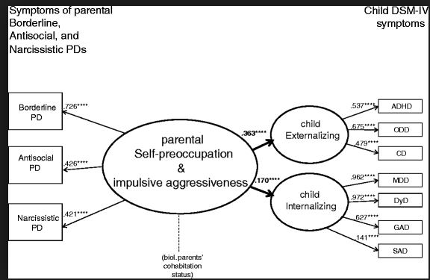

Slide 4
Full SEM
New term:
Reflective indicators / effects indicators
We assume factors cause the indicators, so the arrows go out.
Formative indicators / cause indicators
When we use items to predict a latent (arrows go into the latent).

Slide 5
Full SEM
Example of formative indicator
Income, education level, and occupation all predict your SES
Stress caused by outside factors
Sometimes this is called a composite cause
MIMIC – multiple indicators, multiple causes models

Slide 6
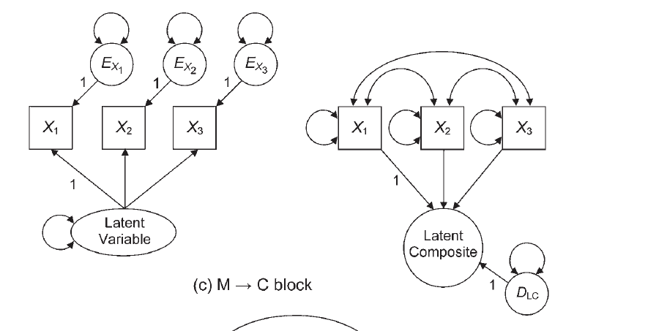

Slide 7
How to identify these?
You still have to have one of them with the one
2+ emitted paths rule
Composite variable must have have direct effects on two other endogenous variables

Slide 8
Things to Consider
Parceling
When you have large structural models, they can be very complex to fit to a Full SEM if each latent variable has lots of indicators (items).
Parceling is creating subsets of items to be able to get the model to run and to balance out the number of indicators on each latent.

Slide 9
Things to Consider
Parceling
At the moment, this topic is still pretty controversial. Many fall into the: this is bad don’t do it camp.

Slide 10
Things to Consider
How to model?
Test each CFA piece separately to make sure they run.***
Slowly add structural paths to see if you can get the full model to work.
If not, try parceling.
Drop non-significant paths.
***if your CFA is bad, the full model will be bad too.

Slide 11
Things to Consider
As you add the structural components, you should not see a big change in the loadings to the indicators
If you do, it means the model is not invariant (a fancy word for doesn’t change)
Called interpretational confounding

Slide 12
Things to Consider
Single indicator latents
Don’t do this. Please.
Just leave it at as a square.

Slide 13
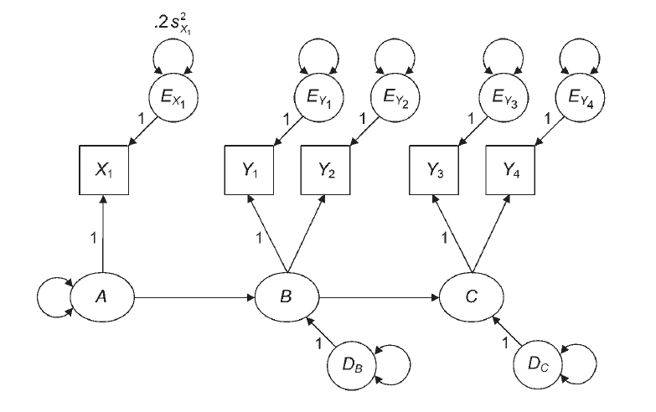
Things to Consider

Slide 14
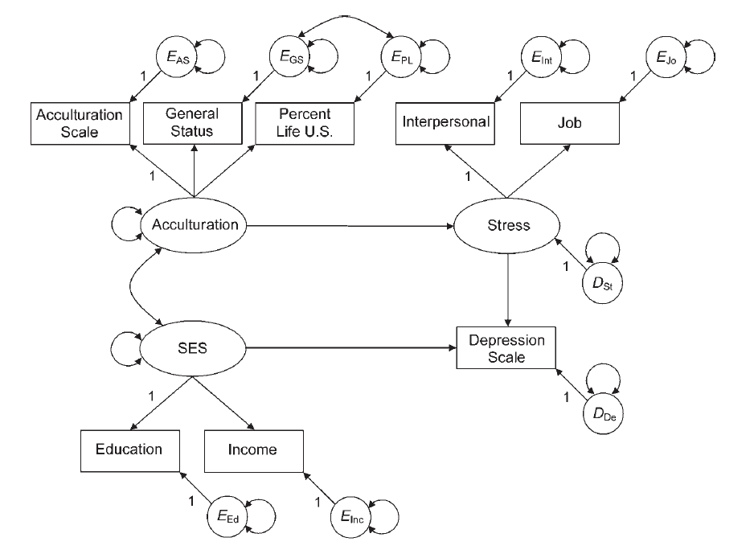

Slide 15
A Small Repeat
Multicollinearity of the latents
When you run into this Heywood problem, but none of the variances are negative
You can check for cross loadings (so-so)
Combine the two latents into one

Slide 16
When to Stop?
We’ve discussed lots of tricks to explore models and improve them.
When do you quit?
Based on theory
Fit indices do not greatly improve
Parsimony

Slide 17
Let’s Try It!
Full SEM (traditional)
Full SEM with composite variables

Slide 18
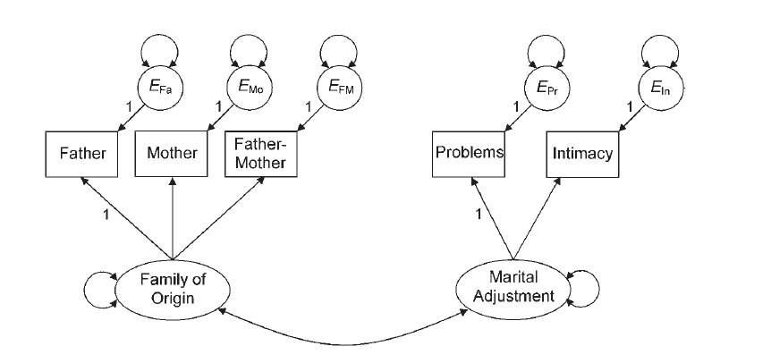
Kline_9_family

Slide 19
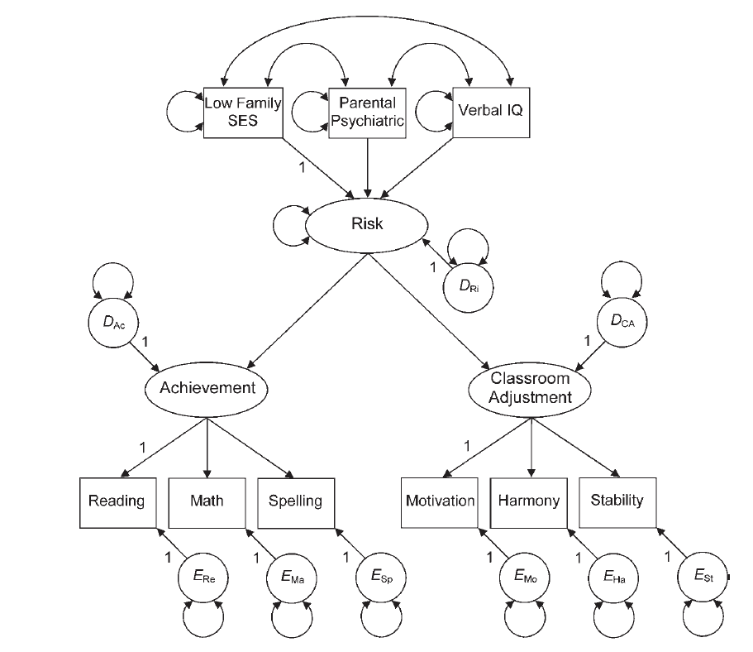
Kline 10 risk

